Slide 1



Nuffield Centre for International
Health and Development
Tracing theories in realist evaluations of large-scale health programmes in low- and middle-income countries
Realism@Leeds webinar series
2 October 2020
Dr Tolib Mirzoev
http://bit.ly/TolibMirzoev @tmirzoev

Slide 2


Structure
Introduction
Tracing theories
  Processes / Phases
  Reflections
Lessons learned

Slide 3
SURE-P / MCH
(Fuel) Subsidy Reinvestment and Empowerment Programme 2012–2015
Improvement of Maternal and Child Health in clusters of 4+1 facilities
SUPPLY
2,000 midwives, 9,000 VHWs and 1,000 CHEWs
infrastructure improvements
equipment, supplies and medicines
DEMAND
CCTs (some clusters) to women for ANC, facility deliveries and vaccinations
Mobilisation of WDCs
Notes:
One component of SURE-P focused on improving maternal and child health, and was implemented in selected Nigerian States in clusters comprising 3-4 PHC facilities and one referral hospital (12-21 facilities within each of 9 States, out of total 36 States having 1,000-4,000 facilities)

Slide 4



The study
COMUNEC:
Prof BSC Uzochukwu
Prof Obinna Onwujekwe
Prof Nkoli Ezumah
Dr Enyi Etyaba
Dr Chinyere Okeke
…
Leeds:
Dr Tolib Mirzoev (PI)
Dr Ana Manzano
Prof Tim Ensor
Dr Bassey Ebenso
Dr Joe Hicks
…
DeteRminants of Effectiveness and sustainability of a noVel community heAlth workers (CHWs) programMe in imProving maternal and child health in Nigeria (June 2015 – Feb 2021)

Slide 5

REVAMP
AIM - is to assess effectiveness and sustainability of achieved changes
Anambra State - 3 clusters
  SURE-P/MCH
  SURE-P/MCH + CCT
  no implementation (‘control’)
Cross-disciplinary and mixed methods realist evaluation

Slide 6
Study conceptual framework

Slide 7
Study design and methods
1) Theory development
2) Theory testing and validation
3) Theory refining and consolidation
Hypothetical pathways that link intervention inputs to outcomes within context
(Document review, IDIs)
Understand process, context and effects incl. sustainability, advocacy and changes in political priorities IDIs
Understand links, modify existing and develop new pathways
Explore views of users
Facility exit survey, exit IDIs and FGDs
Develop model of relations between context, process, outputs and outcomes, using the C-M-O configurations
Assess costs (main & spill over effects)
HMIS and SURE-P costing data
Identify outputs and outcomes, including sustainability
HMIS and SURE-P data
Develop transferable best practices for scalability and generalizability
KEY:
Italics methods and data sources
study progression between phases
examples of links between methods

Slide 8
More details..

Slide 9

Our ‘methods’ paper

Slide 10
Project phases
Phase 1
Phase 2
Phase 3
June-October 2015
Logic map (Ebenso et al, 2019)
Theory gleaning
Nov 2015 – Sept 2017
Developing PTs based on data, literature
Sept 2017 – Dec 2019
Theory testing, validation, consolidation

Slide 11
Evolution of ‘Trust’ and ‘Security’ PTs
Phase 1 (June-Oct 2015)
Phase 2 (Nov 2015 -Sept 2017)
Phase 3 (Sept 2019 -Jan 2020)
Supply-side:
Different incentives (recruitment, supplies, salaries, environment) will improve staff motivation and performance, leading to improved provision of MCH care
S1: Prioritisation of MCH through advocacy
Advocacy helps to prioritise and sustain MCH on the political agenda
Overall theory of change:
combination of elements of systems strengthening to improve equitable access to quality MCH services
S2: Improved staff motivation through incentives
Incentives motivate recruited facility staff to perform their duties well
S3: Staff feeling safer to provide MCH care
Facility security shapes both the provision and utilisation of round-the-clock MCH services
S4: Implications of withdrawal of programme support on staff
Demand-side:
Mobilisation of communities through ward development committees along with incentives (cash transfers, improved facilities) is likely to improve uptake of MCH services
D1: Supporting women to access MCH care
Trust determines staff motivation, performance and uptake of MCH services by local communities
D2: Motivated and better performing village health workers
D3: Distrust due to withdrawal of programme incentives
Different incentives motivate village health workers to better perform their duties
D4: Sustainability of trust in the health system
Notes: (1) dashed lines show indirect links whereas solid lines show direct progression of theories (2) darker grey shows emergence and progression of the Security theory, whereas lighter grey shows the same for the Trust theory

Slide 12
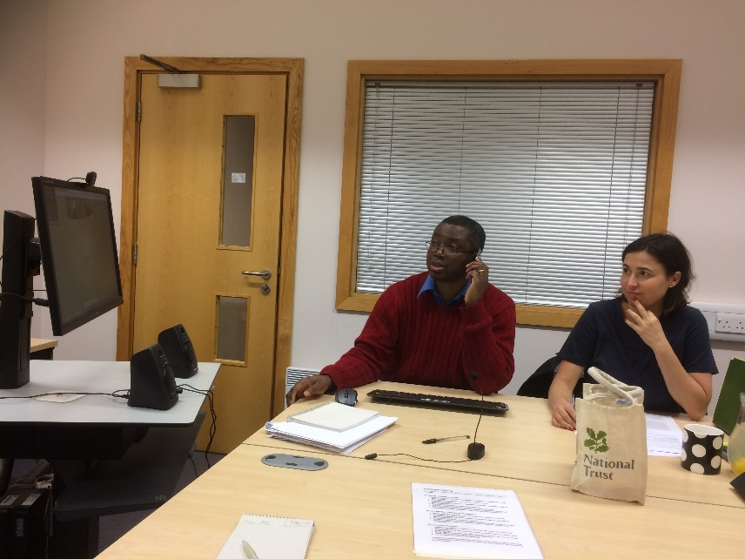
Phase 1 (June-Oct 2015)
Theory gleaning (documents, architects)
HMIS data quality
Literature
Leeds meeting: capacity on RE and IWT
Step - down capacity workshops in Enugu

Slide 13
Phase 1 - reflections
Theory gleaning was driven by programme design (supply-demand)
Security and trust were implicit
Working environment
Infrastructure
Staff performance
Security - clearer in the data (perimeter fencing, night guards) but Trust emerged indirectly (staff motivation, user satisfaction)
Engaged with empirical literature, driven by programme logic

Slide 14
Phase 2 (Nov 2015 – Sept 2017)
In-depth literature review
Empirical + theoretical
Larger data collection
96 IDIs
Data analysis
5 groups over 4 weeks
PTs developed
15 themes
2-day workshop (Enugu, Feb’17)
8 PTs
Costing data
Survey

Slide 15
Phase 2 outputs

Slide 16
Phase 2 - PTs
S3: Health workers feeling safer to work. In the context where health facilities or communities ensure employment of security men, erection of perimeter fences and availability of accommodation for health workers in the facility premises (C), then health workers are likely to feel safer and therefore willing to work (i.e. provide MCH services) during night hours (M), thus ensuring the provision of round the clock MCH services, and improved access to MCH services (O)
D4: Sustainability of trust in the health system. In the context of improved staff attitude, upgraded health facilities and functioning WDCs achieved during implementation of the SURE-P programme, pregnant women who receive sustained financial and non-financial incentives to use MCH services (C), are likely to develop and maintain a sense of improved trust (including confidence and satisfaction) with health facilities and staff (M), ultimately leading to improved likelihood of repeated and regular utilisation of MCH services from these health facilities (O).

Slide 17
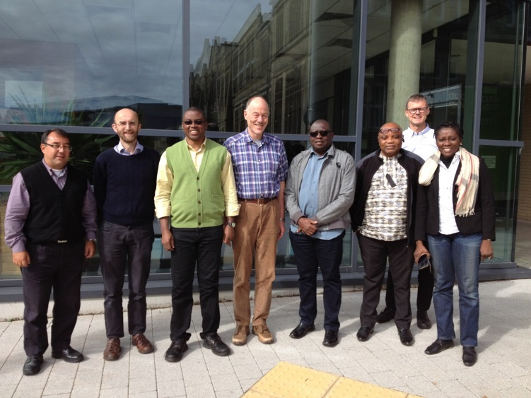
Phase 2 - reflections
Retroductive reasoning → tentative causality propositions included and tested in IDIs
Magnifying glass metaphor
  Engagements with still empirical but increasingly theoretical literature

Slide 18
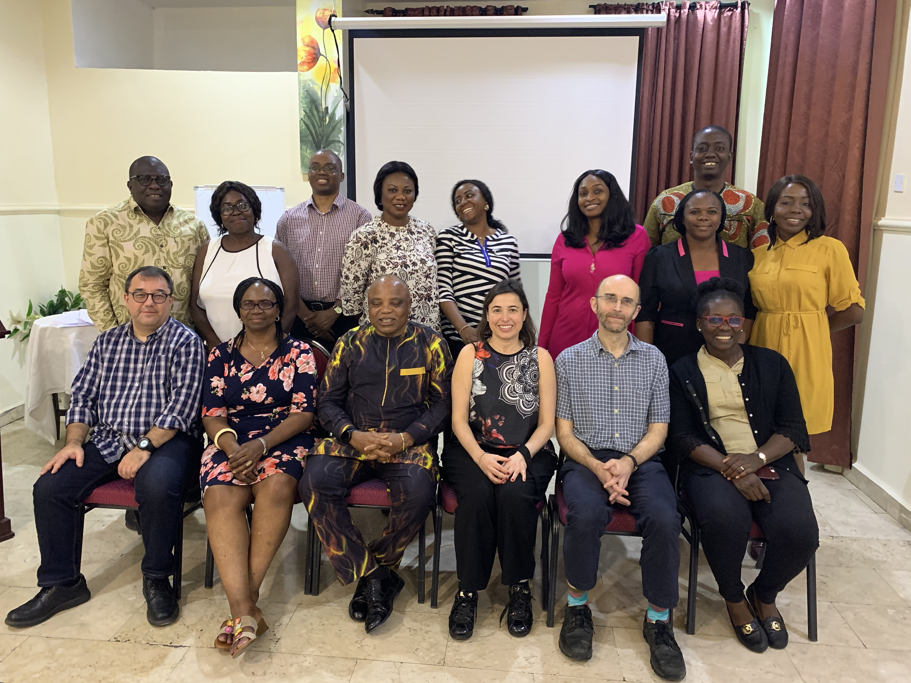
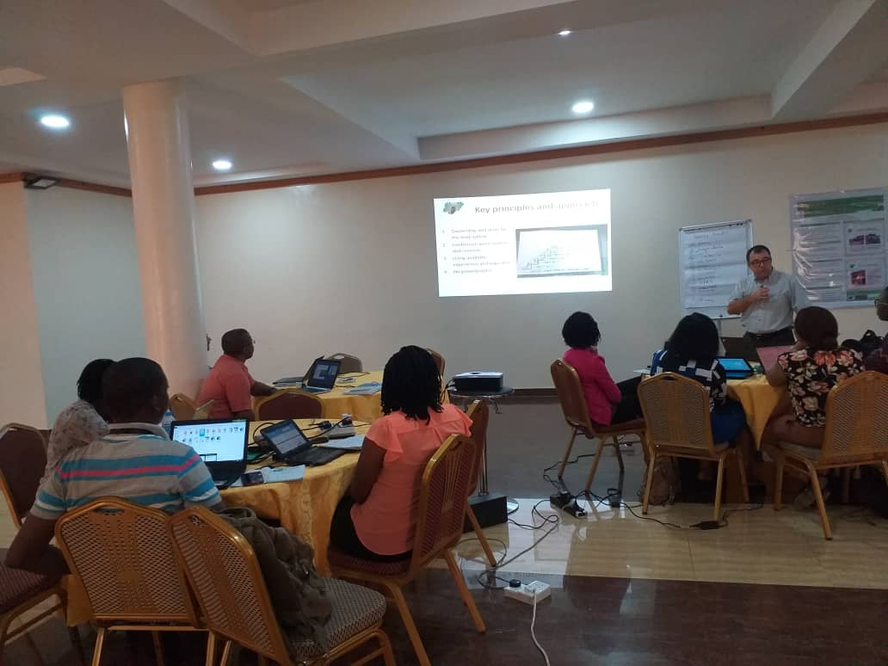
Phase 3 (Sept 2017 – Dec 2019)
Multiple and regular meetings (e.g. Feb 2019)
Smaller-scale (39 IDIs, 4 FGDs) but deeper
Substantive theories in the ‘social lab’

Slide 19
Security PT

Slide 20

Security PT
“A friend of mine who was pregnant came to the health center with her husband in the middle of the night without knowing that the programme had ended. We stood long at the gate and knocked for almost an hour but there was no response. I went to the second gate and it was empty, I got tired and picked a stone and threw it on
the roof. Someone eventually came out” (petty trader).
“… .. many centers don’t have security men. We have about 40 health facilities here… but we have only one security man. Because most deliveries are usually in the night, when these women come shouting, crying … and there is no security man to help assure that the person that has come is actually a pregnant woman and not a robber, the nurse will not come out …” (Policymaker).

Slide 21
Trust PT

Slide 22
Trust PT
“We received drugs here during the SURE P MCH programme free…, they don’t collect money from us because the drugs were free then” (FGD - Service user)
“The incentives were good, it raised people’s spirit up and also made the nurses active, so the trust of people increased as well as the number of people who come to the health center “(FGD - Service user)
Those things that we need (e.g. drugs and mama kits…. which SURE-P used to supply) made people come to the health facility, but now that there is no SURE-P they are not so motivated because of lack of all these, … now when they come and see that the price is high, it makes them to either go to the market, or do self-treatment which can lead to death or other complications (health worker)
“…. Some of them [service users] that came in during SURE-P MCH still continued maybe because they were pleased with what they saw, but then convincing others to come in while the SURE-P had already closed, but some still trust them and come “(health worker)

Slide 23
Theoretical engagements
Security
Trust
Complementary body of interdisciplinary literature on:
Fear of crime and gender (Bennett 1990; Hough & Mayhew 1983).
Fear of crime due to structural factors e.g. layouts of buildings (Dammert & Malone 2003)
Political, socio-economic issues, insecurities e.g. poverty, place (Pain 2000; Stanko 1987)
Progressively selected to capture:
Micro-meso- and macro determinants (Straten et al. 2002)
Taxonomy of factors e.g. safety, capability, predictability (Gilson 2003, Hurley 2006)
Social capital theory (Agampodi et al. 2015; De Silva & Harpham 2007; Szreter & Woolcock 2004) for residual trust

Slide 24
Three conceptual challenges
Levels of abstraction
Comparing CMOs with empirical HS literature vs. engaging with substantive theories at MRT
What causes what
Moving Cs, Ms and Os and resolving circular arguments
What theories to use
Iterative ‘dipping in and out’ of literature against data

Slide 25
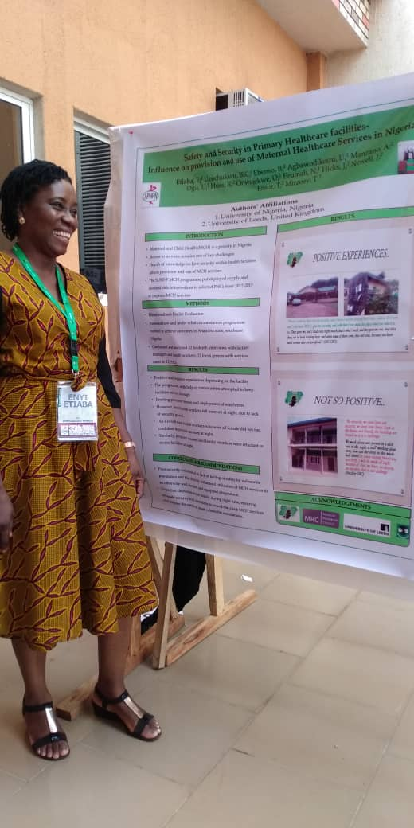
On reflection…
Neither security nor trust were explicit in the programme design
  Security emerged earlier, more tangible?
  Trust is ‘softer’ and cross-cutting
Dataset for security PT was qualitative; for trust also quant (survey, facility data)
Cross-disciplinary expertise (social sciences, economics, statistics, HPSR) enabled deeper engagements

Slide 26
Lessons learned
REs are important, though time-consuming, approaches to generating practical implications for policy and practice
‘Pitching’ theories at right level of abstraction for rigour and policy relevance
Sourcing different nuggets of evidence can be a challenge in resource-constrained settings
Retroductive approach requires expertise and continuous engagements

Slide 27


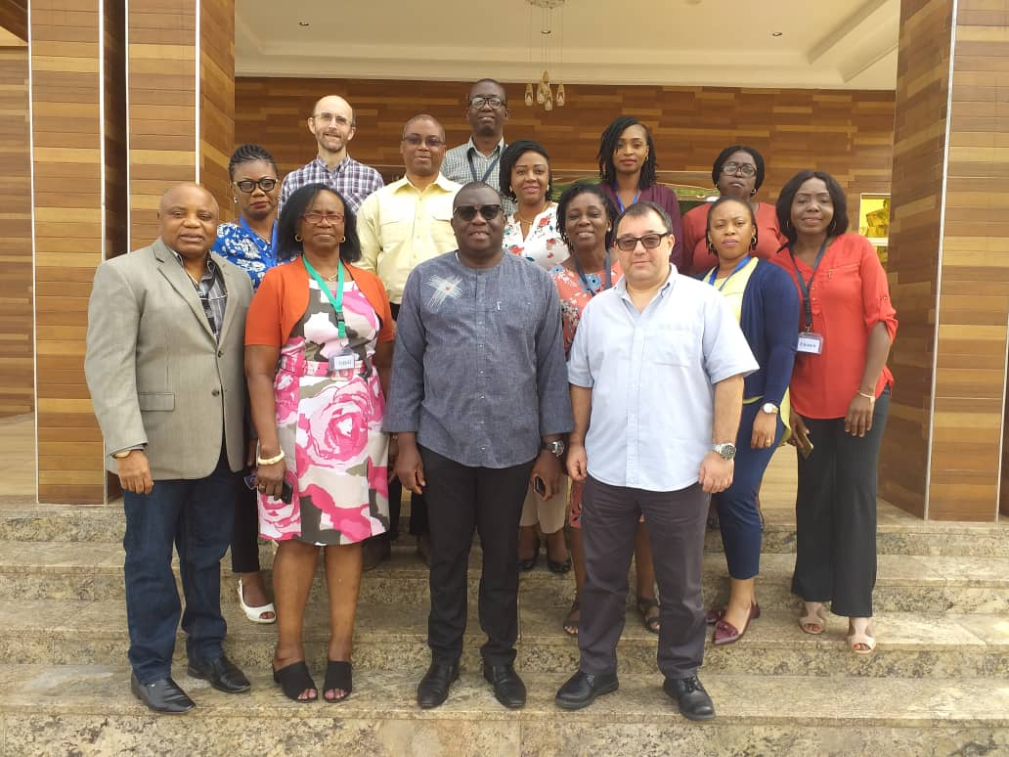
Thank you!
http://bit.ly/REVAMPproject
t.mirzoev@leeds.ac.uk
@tmirzoev

